Slide 1




Life Cycle Assessment of Scooters in Berlin
Comparison between Electric, Two-Stroke, and Four-Stroke Models
Presented By:
Mohammed Alyami -

Slide 2



TABLE OF CONTENTS
01 02
Goal & Scope
Functional Unit
Assumptions and Limitations
03
LCIA Method
04

Slide 3
TABLE OF CONTENTS
Life Cycle Inventory
Conclusions and Recommendations
05
06

Slide 4

01
Goal and Scope

Slide 5
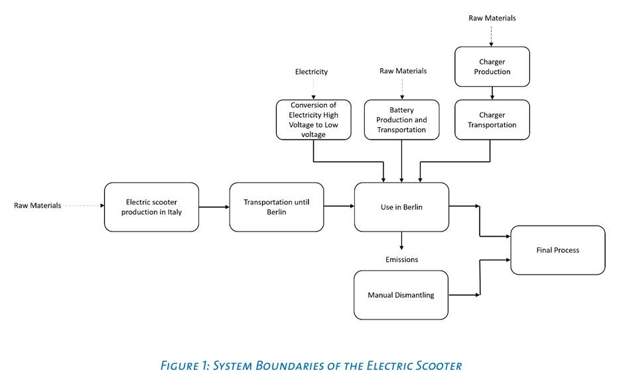

Goal
Compare the environmental impacts of 3 scooters (Electric, Two-Stroke, Four-Stroke) from cradle to
grave in Berlin, Germany
Identify hotspots to propose improvement strategies
Apply Life Cycle Assessment (LCA) approach using openLCA software and ecoinvent 3.6 database

Slide 6
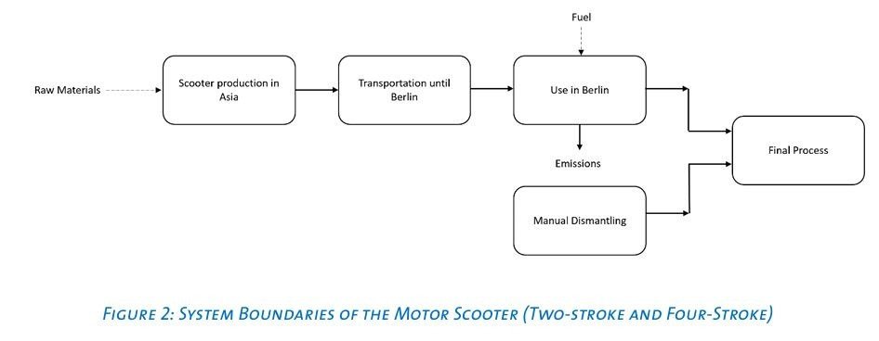
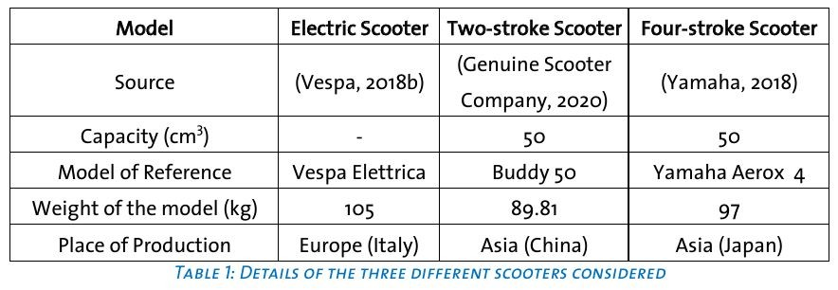
Scope
Includes all life cycle stages:
Production
Transportation
Use phase
End of Life (manual dismantling and disposal)
Focus area: Berlin, Germany

Slide 7
02
Functional Unit

Slide 8
Functional Unit
Functional Unit: 1 person-kilometer (p*km)
Total distance considered: 55,000 p*km (50,000 km * 1.1 passengers)

Slide 9
03
LCIA
Method

Slide 10
LCIA Method
Method: ReCiPe 2016 Midpoint (H)
Covers Global Warming, Fossil Resource Scarcity, Human Toxicity, Particulate Matter, etc.
Same method applied to all scooters for fair comparison

Slide 11
04
Assumptions and Limitations

Slide 12
Assumptions
Life expectancy same for all scooters: 50,000 km
Battery and charger for electric scooter assumed to be produced in China
One battery assumed for entire life of electric scooter
Manual dismantling assumed for all models
Use phase modeled for emissions, road maintenance, etc. based on literature and ecoinvent database

Slide 13
Limitations
Two-stroke and Four-stroke scooters modeled as same production process (although
real-life processes may differ)
Emissions data for Four-stroke partly based on modified Two-stroke values
Only selected emissions compounds considered
Electric scooter battery data not specific for scooters (general EV battery models used)

Slide 14
05
Life Cycle Inventory

Slide 15
Life Cycle Inventory: Production
Electric scooter production excludes battery.
Two-stroke and Four-stroke scooters modeled the same for production (only weight differs).
Two battery production scenarios modeled for electric scooter:
(1) Generic ecoinvent battery.
(2) Frankfurt Airport battery.
Production process selection depends on scooter model and battery scenario.

Slide 16
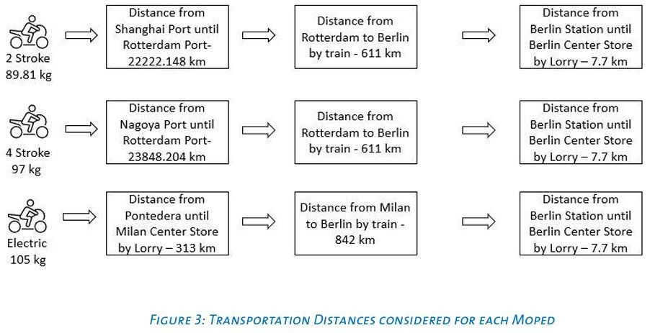
Life Cycle Inventory: Transportation
Two-stroke and Four-stroke scooters transported from Asia:
Ship → Rotterdam
Train → Berlin
Lorry → City center
Electric scooter transported from Italy:
Lorry → Milan
Train → Berlin
Lorry → City center
Transportation routes and distances affect emissions and impacts.

Slide 17
Life Cycle Inventory: Use Phase
Electric scooter:
Requires electricity → 4.128 kWh per charge, 500 charges total.
Three electricity mixes considered:
ecoinvent average
German Green Mix
Airport electricity mix
Electricity source strongly affects impacts (especially global warming).
Fuel scooters:
Two-stroke fuel consumption → 40.8 km/L
Four-stroke fuel consumption → 45.45 km/L
Emissions calculated from real emission factors → adjusted using literature.
Use phase is dominant for two-stroke emissions.
Road use, road maintenance, and scooter maintenance impacts also included during use phase.

Slide 18
Life Cycle Inventory: End of Life
Manual dismantling assumed for all scooters.
Process modeled based on electric scooter and passenger car dismantling data.
Materials sorted for recycling, reuse, and disposal.
End of life process impacts included in LCA.

Slide 19
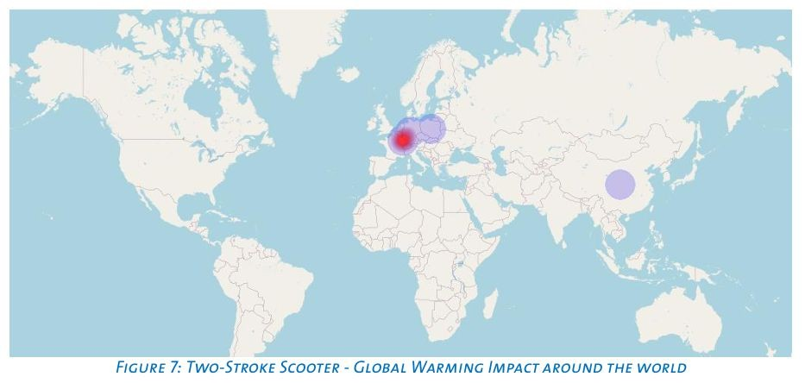
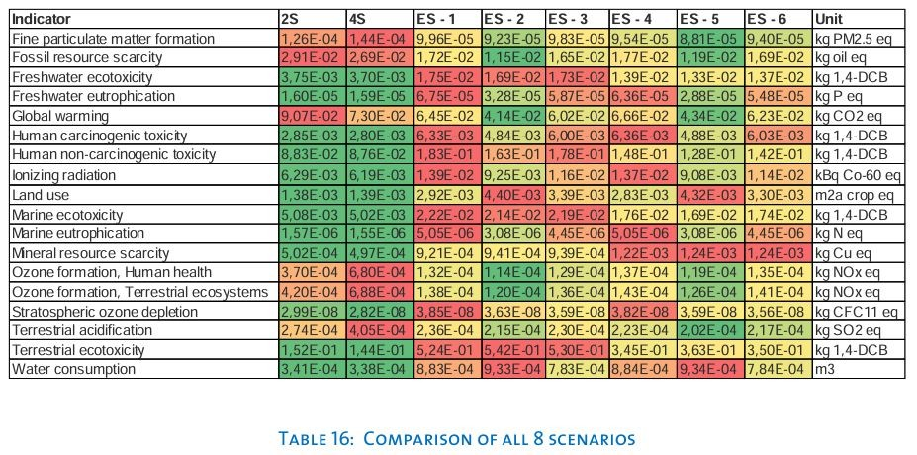
Life Cycle Impact Assessment (LCIA) Results Summary
Use phase dominates Two-stroke impacts (CO, VOCs, particulates)
Four-stroke better but higher NOx
Electric scooter shows lowest use-phase emissions, but sensitive to electricity mix and battery type

Slide 20





06
Conclusions and Recommendations

Slide 21
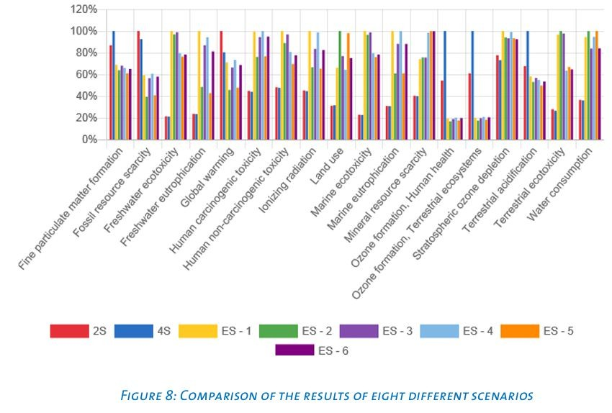
Conclusions
No clear best scooter
Two-stroke is the worst for urban air quality
Four-stroke better, but emissions still considerable
Electric best if powered by green energy; worst if electricity is fossil-fueled

Slide 22
Recommendations
Promote greener electricity to improve electric scooter LCA
Gradual phase-out of Two-stroke scooters
Encourage recyclable and eco-designed scooters
More accurate data collection needed for precise LCA in future

Slide 23
THANKS!

